Slide 1



Transfer learning using VGG-16 for
accident detection using images
By
Abhinay Yadav(RA2011047010116)
Saifeen Naaz(RA2011047010127)
Disha Manoj Jain(RA2011047010130)
Padala Venkata Yeshwanth(RA2011047010131)
Himanshu Kumar Singh(RA2011047010137)

Slide 2


Abstract
Real-world traffic surveillance recordings need constant monitoring in order to detect and respond to deadly incidents. Being constantly monitoring vehicles while they're in motion can be very time-consuming and prone to error. Therefore, to detect accidents using images, one of the pre-trained models – VGG - 16 with Convolutional Neural Network has been proposed in the article.

Slide 3
Introduction
To ensure accident detection accuracy, this paper produces a VGG-16 model with Convolutional Neural Network applied to road accident images. We have used the transfer learning approach because using a feature space and distribution model to separate the data collected by the algorithm from the rest does not hold true for the real world. This accident detection model will aid in not only improving incident management reaction times and offering rapid assistance to victims, but also verifying the occurrence of accidents by police departments and insurance firms.

Slide 4
Motivation
To detect accidents from single image.
Most of the model detects accidents using video image by tracking attributes like vehicle speed. Hence, they cannot be used to detect accidents from a single given image.

Slide 5
Proposed Methodology

Slide 6
Dataset- The dataset used is created by extracting images in the folder Accident -Detection of Accident Images Analysis Dataset. The generated Dataset comprises of 140 accident images and 140 non-accident images

Slide 7
Image Data Generator is used to generate batches of tensor image data with real – time data augmentation.
Parameters used:
samplewise_center= True
rotation_range= 10
zoom_range= 0.1
width_shift_range= 0.1
height_shift_range= 0.1
horizontal_flip= True
vertical_flip= True

Slide 8
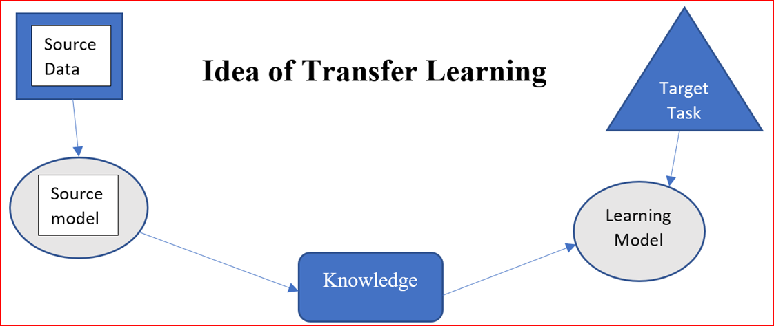

Slide 9
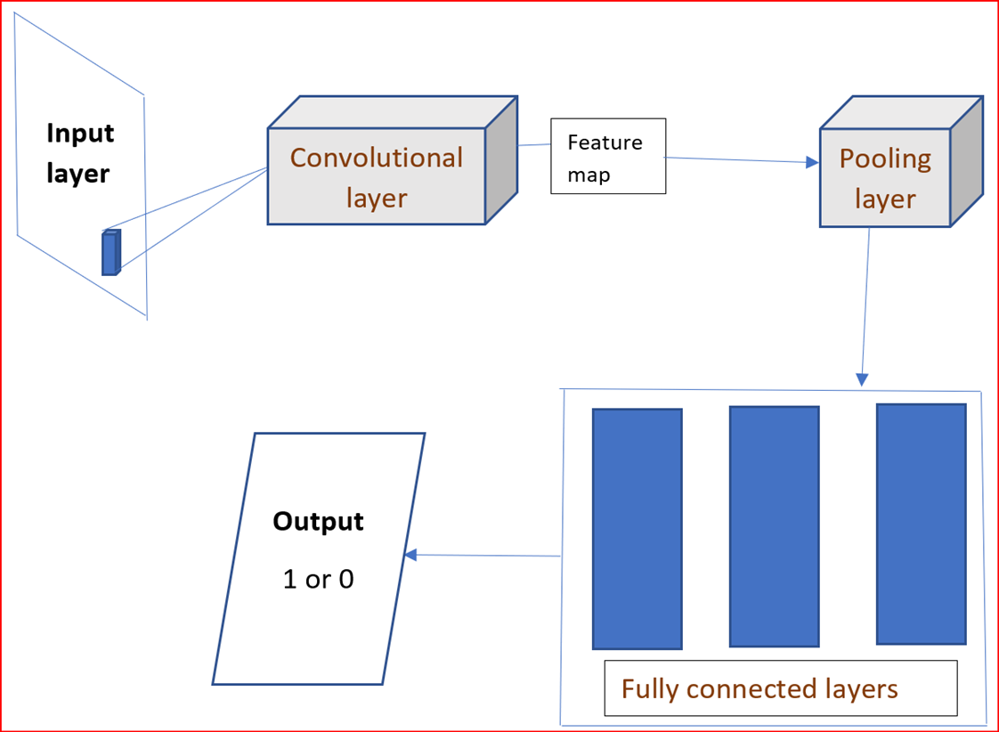

Slide 10
VGG-16
VGG – 16 is a Convolutional Neural Network architecture trained on the Imagenet dataset.

Slide 11
The model suggested uses only these weights and therefore, fully connected layers of VGG – 16 are not downloaded. Instead, our own global average pooling layer is added to detect accidents.
The Global Average Pooling layer is added in the last of the model to extract features. The prepared model is trained with 8 epochs having 12 steps per epoch and validated with 4 validation steps and 10 workers. The loss function used in Binary Crossentropy and optimized with a learning rate of 0.00001.

Slide 12
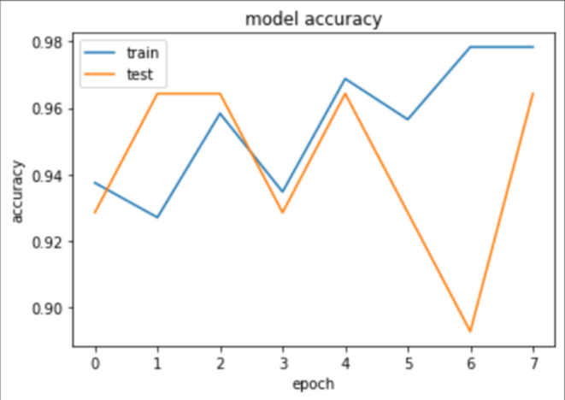
Results
Training and validation accuracy plot by applying CNN with pre-trained VGG-16 model and image augmentation.
As depicted by the plot, the training accuracy is 97.83% and validation accuracy is 96.43%.

Slide 13
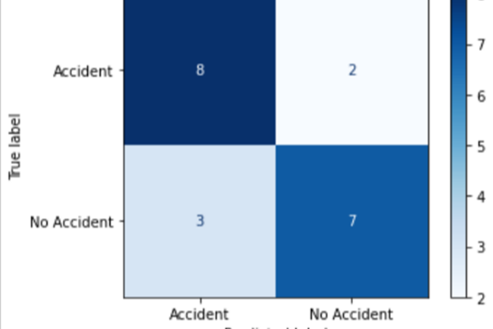
Precision= 80%
Recall= 72.7%

Slide 14
Comparative Results
Training accuracy Validation accuracy
CNN with image augmentation 88.54% 85.71%
CNN with pre-trained VGG-16 model and image augmentation 97.83% 96.43%

Slide 15
Conclusion
This paper discussed CNN model with pretrained VGG-16 and image augmentation for detecting accidents using images. The introduction of this project will be useful in reducing the response time of the crash detection and hence, ensuring speedy incident management. It will also be helpful in verifying the occurrence of accidents by police departments and insurance firms.

